Slide 1
Hotspotter Beta
Developers
Dylan Williams Quality Assurance
Spencer Smith Customer Proxy
Nathan Reinhardt Scrum Master
Client
Dr. Igor Crk Southern Illinois University Edwardsville Department of Computer Science Edwardsville, IL 62026-1656

Slide 2
Major Functionality of Beta Release
Adding Public Git Repository
Cloning to server
Saving to database
Parsing Git Repository
Creating file structure in database
Recording all file commits
Scoring Files
Number of Commits, Frequency of Commits, Time Since Commit
Graph Display
Score versus Time

Slide 3
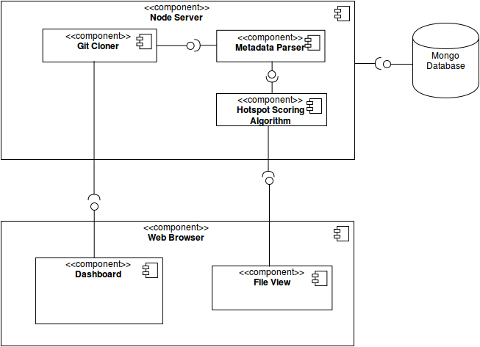

Slide 4
Demonstration

Slide 5
Remaining Development
Data Export
CSV, Excel
Repository Sync
Pull rather than clone
Analyze Data
Identify trends
Observe effects of bug fixes

Slide 6
Beta Release Feedback
Consult with Dr. Crk after a week of testing in his hands.
Document any concerns.
Address concerns during next sprint.

